Slide 1

Automation Testing
By- Manas

Slide 2
ACTIONS
We are using actions to perform miscellaneous operations like Mouse Movements, Sendkeys, Double Clicks, Drag And Drop, ClickandHold etc..
For working with Actions, we need to import Actions class by creating object.
Syntax: Actions object=new Actions(WebDriver Driver)

Slide 3
Sending Keyboard Operations using Actions:
We are using Actions also for sending Keyboard operations to the application.
Syntax: Actions object=new Actions(WebDriver Driver)

Slide 4
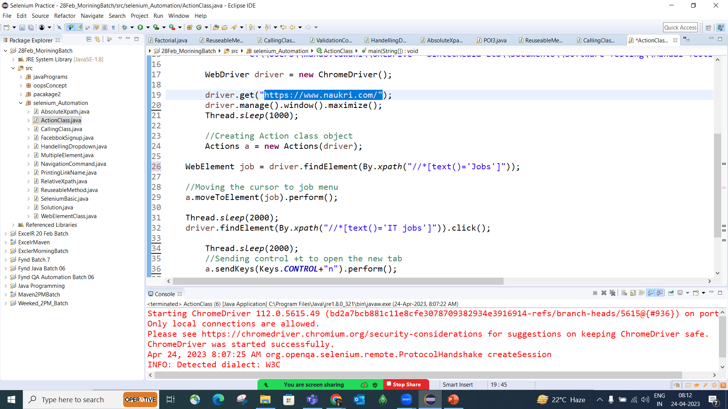

Slide 5
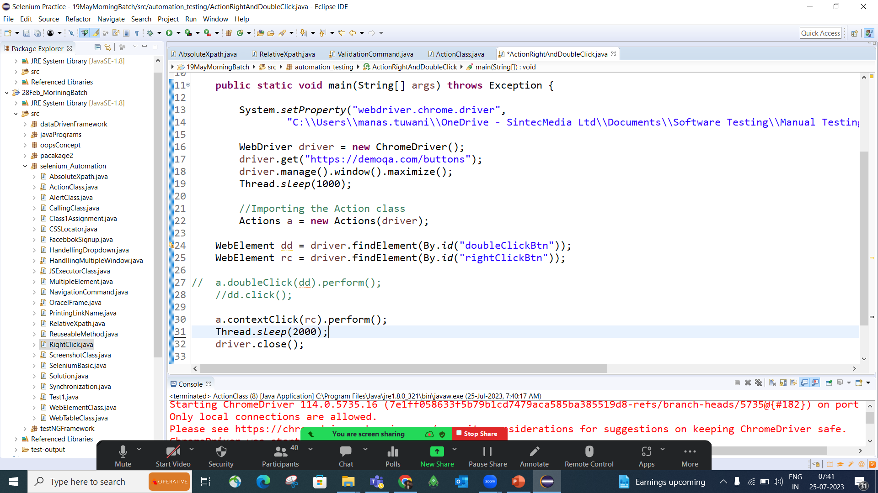

Slide 6
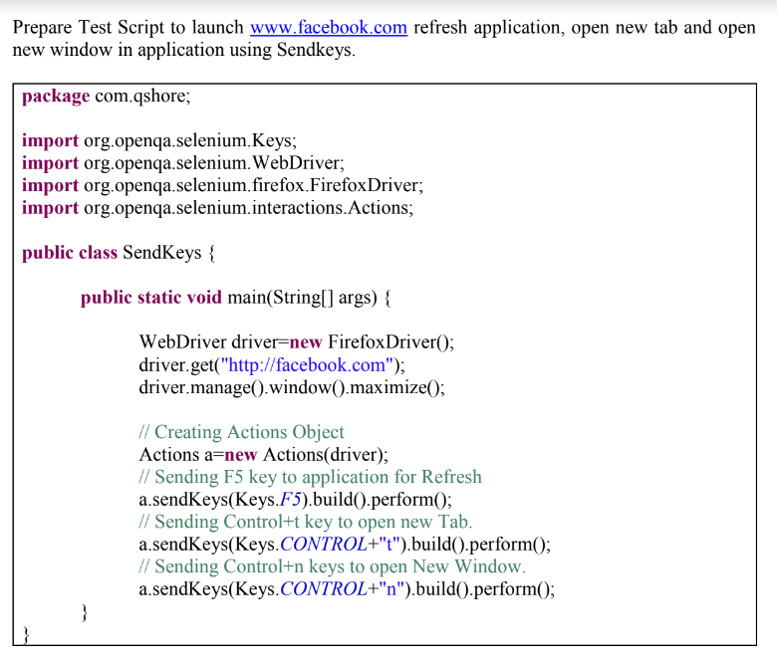

Slide 7
FAQ’s
How you will perform Mouse moment operation in Selenium
Which method you will user for right clicking on any element
Which method you will user for Mouse moment operation
Actions class is present in which package

